Slide 1

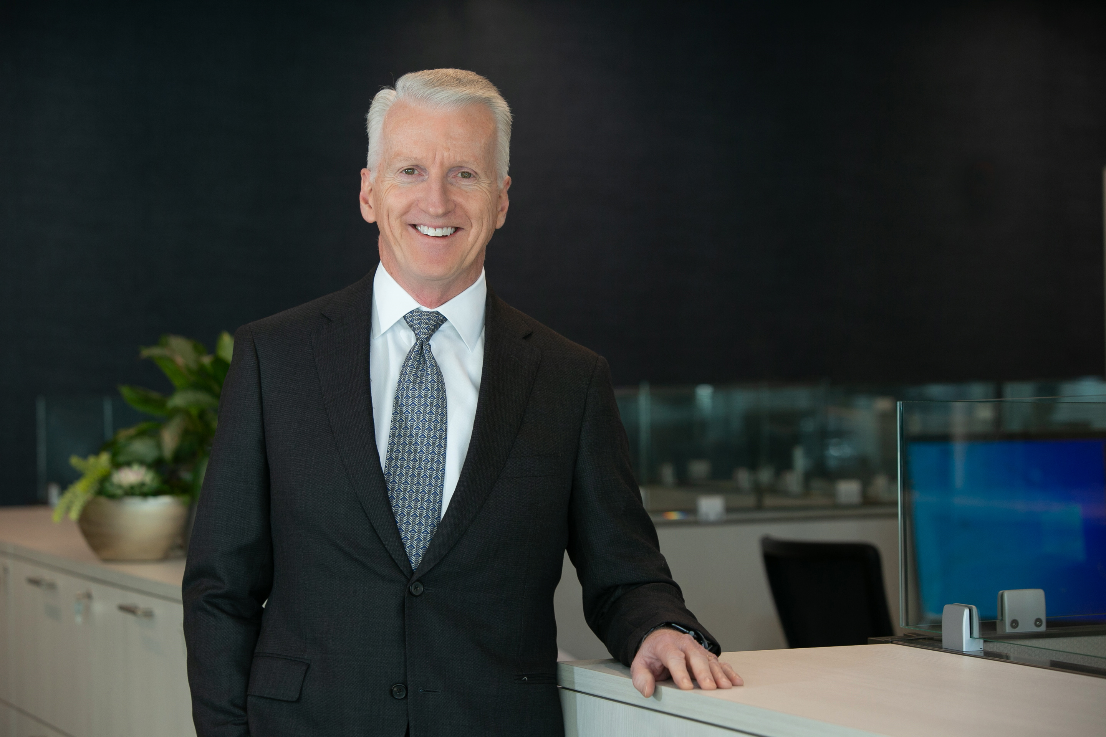
Fixed Income Investment Team
Brian S. Allen, CFA
Chief Investment Officer | Portfolio Manager
EXPERIENCE
Mr. Allen has extensive experience managing fixed income portfolios. Before joining C.S. McKee, he managed fixed income funds for institutional clients at Patterson Capital Corporation in Los Angeles. There he also directed research on mortgage-backed, asset- backed and other fixed income securities. He has also served as a Large Cap Value equity and municipal fixed income manager at C&S/Sovran Trust Company (B of A).
EDUCATION
A market technician, Mr. Allen holds the Chartered Financial Analyst designation as well as an M.B.A. in finance from the Wharton School, University of Pennsylvania and a bachelor's degree with honors in Business Administration from James Madison University.
PERSONAL
An occasional golfer, Brian’s interests also include food, wine, travel, music and real estate. He is a member of the Pittsburgh chapter of the Society of Financial Analysts and serves as Treasurer for The Pittsburgh Child Guidance Foundation. He, his wife Rachel and daughter Kathryn live in the Sewickley area of Pittsburgh.
Mr. Allen is responsible for investment strategy and oversight of the Equity, Tactical, and Fixed Income investment teams.

